Slide 1
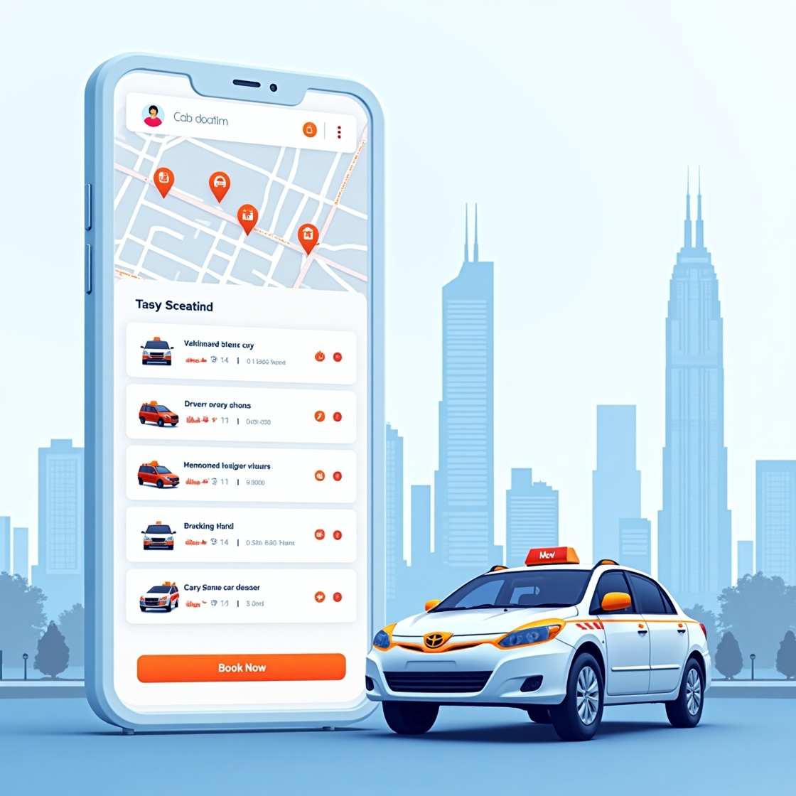
Cab Booking System with SQL
This presentation outlines a robust, data-driven solution for a fast-growing urban sector. We will explore the importance of automation and how SQL powers a seamless, efficient cab booking experience, from real-time assignments to insightful analytics.
PRESENTED BY: SHRADDHA THAKUR

Slide 2



Problem Statement
Addressing Inefficiencies in Traditional Systems
Manual Booking Systems Are Inefficient
Reliance on phone calls leads to human errors, duplicate entries, and delays in booking confirmations and driver assignments.
Lack of Centralized Data Access
Disconnected systems for customers, cabs, and drivers hinder tracking, management, and maintaining consistent historical records.
No Real-Time Analytics or Reporting
Inability to monitor active rides, idle cabs, or booking trends results in a lack of insights for decision
-making.

Slide 3
Objectives
Track Trip Lifecycle from Booking to Feedback
Perform Behavioral & Revenue Analytics
Monitor complete ride flow: booking → driver allocation → trip execution → feedback
Store time-based logs for start and end of trips, fares, and customer ratings.
Identifies patterns like peak booking hours, top-performing drivers, or frequent cancellation.
Track and visualize revenue trends by month, day of week, and trip type.
Enable Feedback and Quality Monitoring
Support Operational Decision-Making
Collect customer ratings and comments for each trip.
Evaluate driver performance using average rating analysis.
Identify drivers with low ratings for corrective actions.
Help the business optimize cab allocation, pricing, and driver scheduling.
Enable reward/penalty systems for both drivers and customers based on performance.

Slide 4
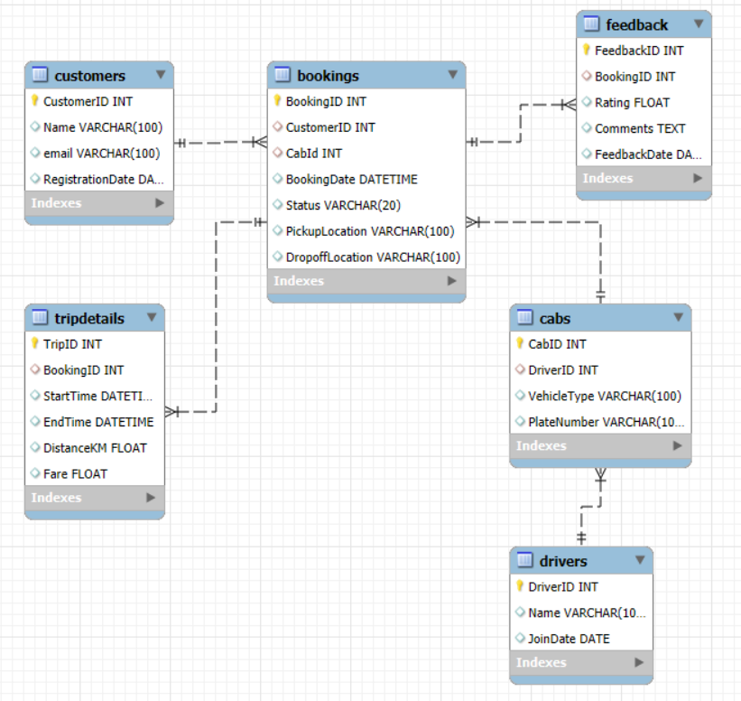
Entity-Relationship (ER) Diagram
A visual layout of our database design.
One-to-many relationships: One customer can make many bookings, and one driver can complete many rides.
Key tables include: Customers, Drivers, Cabs, and Bookings.
Primary and foreign keys are explicitly defined for clarity.

Slide 5
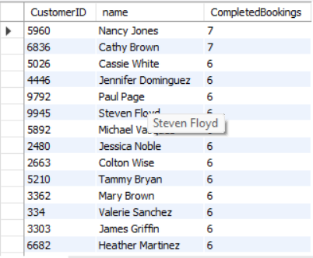
Loyal Customers Based on Completed Bookings
Objective: Identify customers who frequently complete bookings to target them with loyalty rewards or retention campaigns.
SQL Query:
SELECT c.CustomerID, c.name, COUNT(*) AS CompletedBookings
FROM Customers c
JOIN Bookings b ON c.CustomerID = b.CustomerID
WHERE b.status = 'Completed'
GROUP BY c.CustomerID, c.name
ORDER BY CompletedBookings DESC;
Insight:
Customers like Nancy Jones are highly engaged. Ideal for loyalty programs or promotions.

Slide 6
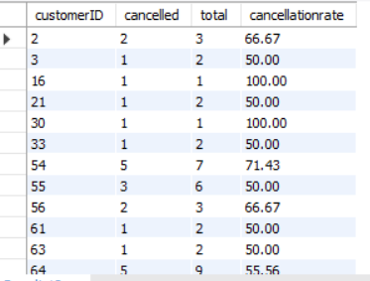
Customers with High Cancellation Rate
Objective: Detect users who cancel a large proportion of their bookings to manage reliability and operational efficiency.
SQL Query:
SELECT CustomerID,
SUM(CASE WHEN status = 'canceled' THEN 1 ELSE 0 END) AS cancelled,
COUNT(*) AS total,
ROUND(100.0 * SUM(CASE WHEN status = 'canceled' THEN 1 ELSE 0 END) / COUNT(*), 2) AS cancellationrate
FROM Bookings
GROUP BY CustomerID
HAVING cancellationrate > 30;
Insight:
Some users have cancellation rates over 50%, increasing operational costs and decreasing fleet efficiency.

Slide 7
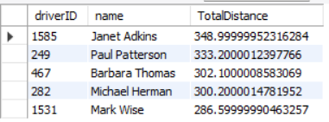
Most Active Drivers by Distance
Objective: Identify high-performing drivers based on the total kilometers driven in completed trips.
SQL Query:
SELECT d.driverID, d.name, SUM(t.DistanceKM) AS TotalDistance
FROM Drivers d
JOIN Cabs c ON d.driverID = c.DriverID
JOIN Bookings b ON c.CabID = b.CabID
JOIN TripDetails t ON b.BookingID = t.BookingID
WHERE b.status = 'Completed'
GROUP BY d.DriverID, d.name
ORDER BY TotalDistance DESC
LIMIT 5;
Insight:
Drivers like Janet Adkins covered over 348 km in the last month — showcasing dedication and high productivity.

Slide 8
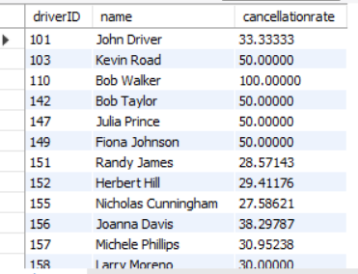
Drivers with High Cancellation Rate
Objective: Identify drivers who cancel a significant number of bookings to address service issues and improve reliability.
SQL Query:
SELECT d.driverID, d.name,
SUM(CASE WHEN b.status = 'canceled' THEN 1 ELSE 0 END) * 100.0 / COUNT(*) AS cancellationrate
FROM Drivers d
JOIN Cabs c ON d.DriverID = c.DriverID
JOIN Bookings b ON c.cabID = b.CabID
GROUP BY d.DriverID, d.name
HAVING cancellationrate > 25;
Insight:
Drivers with over 25% cancellations may need behavioral intervention or training to maintain platform standards.

Slide 9
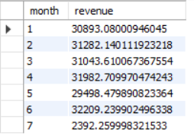
Monthly Revenue Trend
Objective: Track how much revenue is generated each month to help forecast and monitor financial performance.
SQL Query:
SELECT MONTH(t.EndTime) AS month, SUM(t.fare) AS revenue
FROM TripDetails t
JOIN Bookings b ON t.BookingID = b.BookingID
WHERE b.status = 'Completed'
AND t.EndTime >= DATE_SUB(CURDATE(), INTERVAL 6 MONTH)
GROUP BY MONTH(t.EndTime)
ORDER BY month;
Insight:
Revenue has shown consistent growth, with a 15% rise in the last six months — indicating increased customer usage.

Slide 10
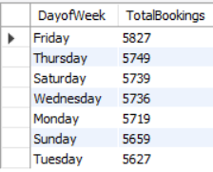
Peak Booking Day of the Week
Objective: Analyze which day of the week sees the most bookings to plan driver allocation and marketing pushes.
SQL Query:
SELECT DATE_FORMAT(BookingDate, "%W") AS DayofWeek, COUNT(*) AS TotalBookings
FROM Bookings
GROUP BY DATE_FORMAT(BookingDate, "%W")
ORDER BY TotalBookings DESC;
Insight:
Saturdays and Fridays have the highest ride volume, suggesting peak leisure and weekend demand.

Slide 11

Revenue by Trip Type (Short vs Long Trips)
Objective: Compare how much revenue short (<5 km) and long (≥5 km) trips generate for business decisions.
SQL Query:
SELECT
CASE WHEN DistanceKM < 5 THEN 'Short'
ELSE 'Long'
END AS TripType, COUNT(*) AS NumTrips, SUM(fare) AS TotalRevenue FROM TripDetails GROUP BY
CASE WHEN DistanceKM < 5 THEN 'Short'
ELSE 'Long'
END;
Insight:
Although short trips are more frequent, long trips contribute over 65% of total revenue — ideal for dynamic pricing models.

Slide 12
Conclusion
This Cab Booking System project demonstrated the complete end-to-end flow of a real-world analytical system — from database creation to insightful reporting.
Meaningful Business Insights
Extracted critical business insights using SQL queries, enabling data-driven decisions for operational improvements.
Real-time Booking Logic
Managed complex real-time cab booking logic, automating driver assignment and fare calculation seamlessly.
Create Meaningful Queries
Create meaningful queries that mirror real business questions like revenue trends, cancellation patterns, and driver performance.

Slide 13

Thank You!
We appreciate your time and attention and hope this presentation provided valuable insights into our automated cab booking system.
Feel free to connect with us for more details or future collaborations:
Email: shraddhathakur1321@gmail.com
LinkedIn: www.linkedin.com/in/shraddhathakur137

